Slide 1
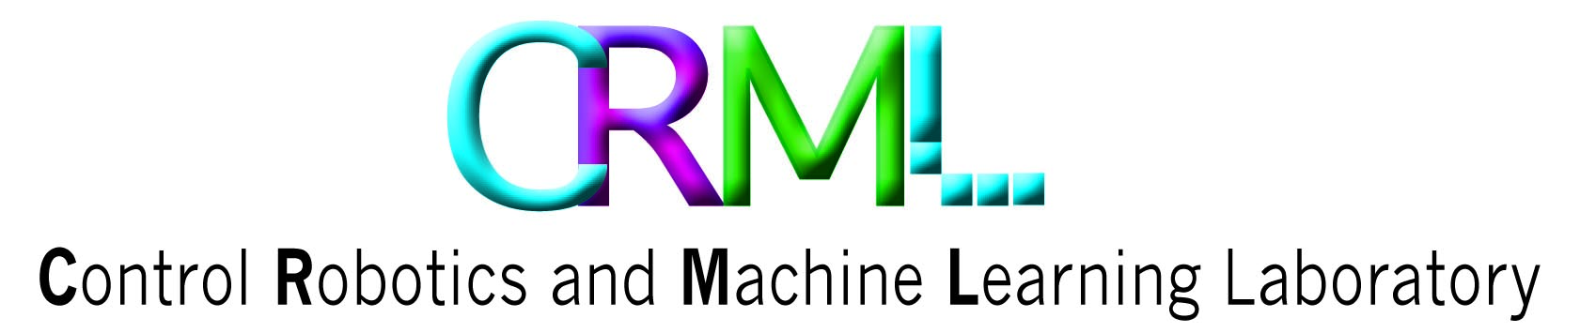
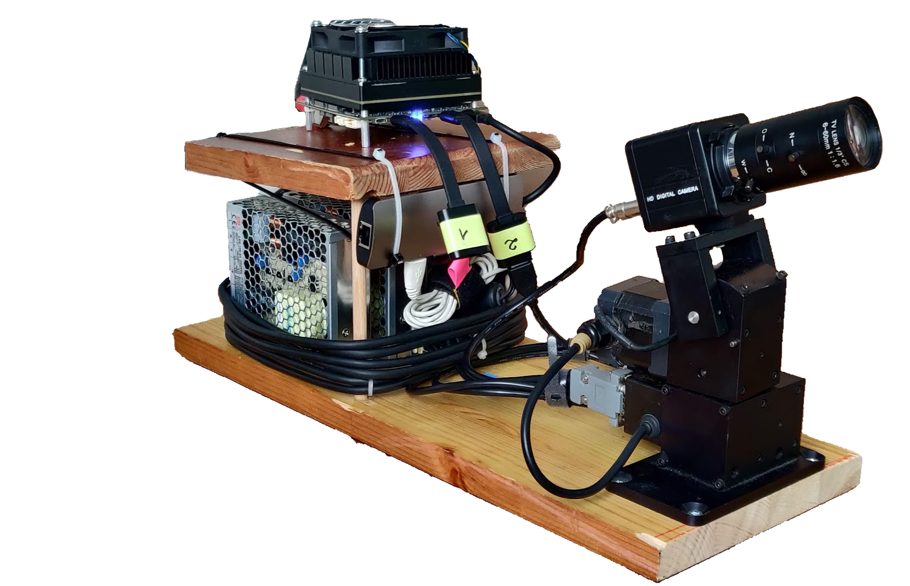
Controlling A Gimbal to Follow A Drone, Handling Input Delay with Prediction
Amir Sarig & Idan Anner
Supervised by Ilan Rusnak
1/36
Notes:
Edited

Slide 2
Outline
Introduction
Background & Motivation
Objectives
Academic Sources
Hardware Overview
Block Diagrams
Integration
Driver
Arduino
In-Depth Control Review
System Modeling
Kalman
Controller
Forward Prediction
Performance
Summary & Conclusion
Questions
2/36

Slide 3

Introduction

Slide 4
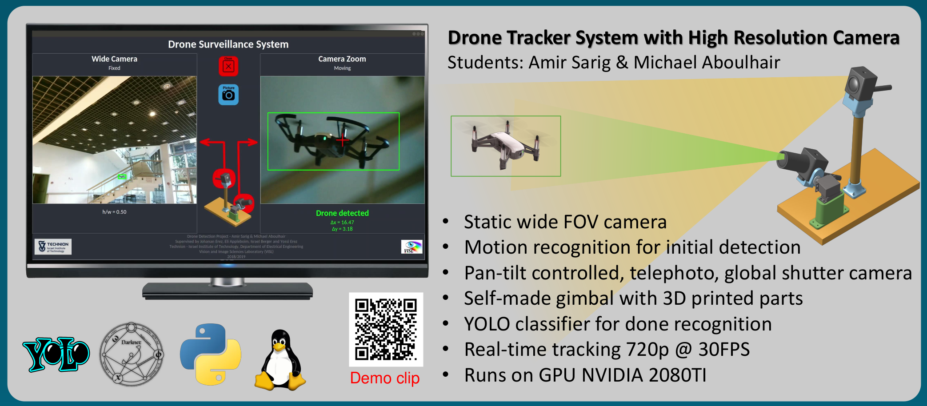
Introduction - Background & Motivation
3/36
Notes:
This project interfaces with project #5425 at VISL Laboratory

Slide 5
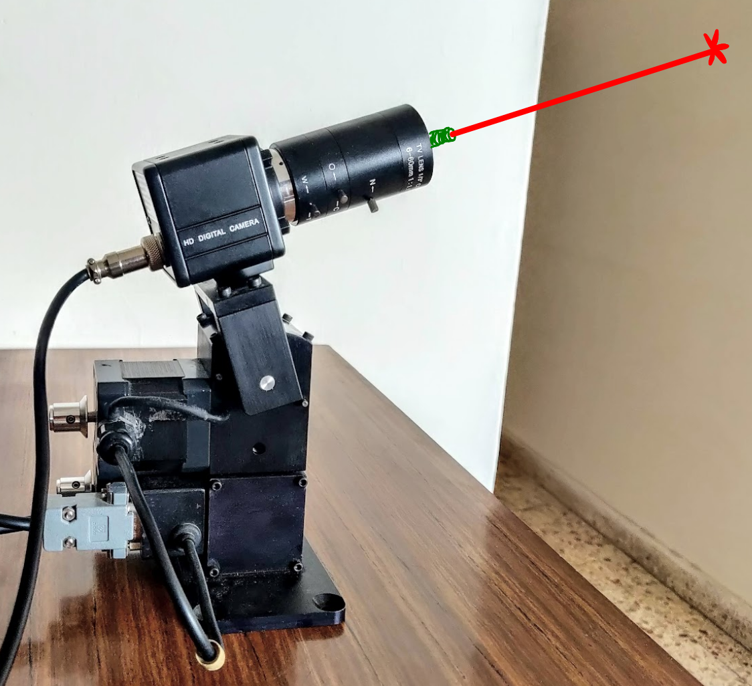
Introduction - Background & Motivation
Recording fast moving object like birds, bats or insects.
Shooting down military invasive targets
Maintaining beam based communication with a moving system
4/36

Slide 6
Introduction - Objectives
Operational Objective:
Point a laser beam to this drone as accurately as possible.
Educational Objective:
Understand the main consideration of designing a discrete controlled following system
Learn the right development workflow of such system
Feel the main bottlenecks of such a system including noises, delays, amplifications etc.
Get a sense of the limitations of such a cheap setup
5/36

Slide 7

Introduction - Academic Sources
Direct Versus Indirect Line of Sight (LOS) Stabilization (Article)
Feedback Control of Dynamic Systems, 8th Edition (Book)
Technion Control Theory 2 course Tutorials
6/36

Slide 8
Hardware Overview

Slide 9
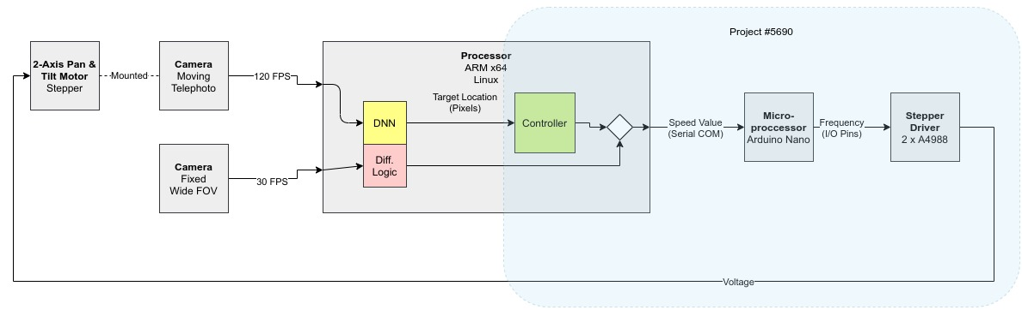
Hardware Overview - Hardware Diagram

Slide 10
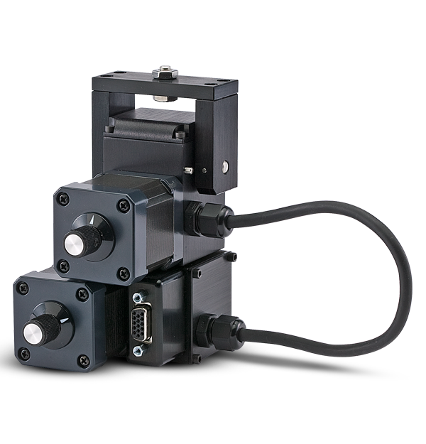
Hardware Overview - The Gimbal
Model: Flir PTU-46-17.5
Motors Type: Stepper, open loop (NEMA 17)
Step size: 1.8 [deg]
Resolution: 0.05 [deg]
Max. Speed: 300 [deg/sec]
7/36

Slide 11
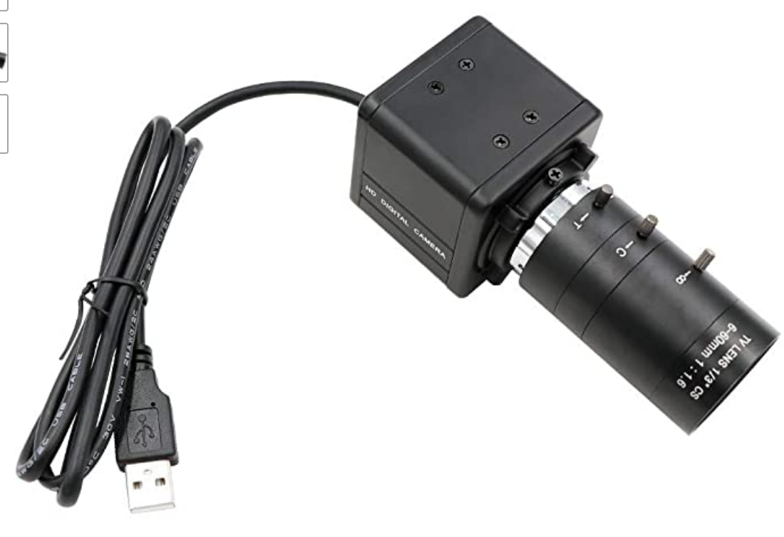
Hardware Overview - The Camera
Model: Kayeton 6-60mm High Speed
Zoom Type: Fixed, Tunable
Frame Rate: 120 [FPS]
Resolution: 1280x720 [pixels]
E2E Delay: [sec] ( as measured by us)
8/36

Slide 12
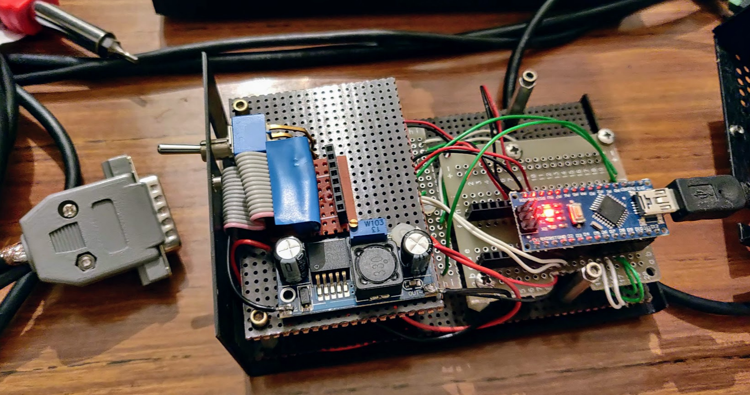
Hardware Overview - The Stepper Driver
9/36

Slide 13
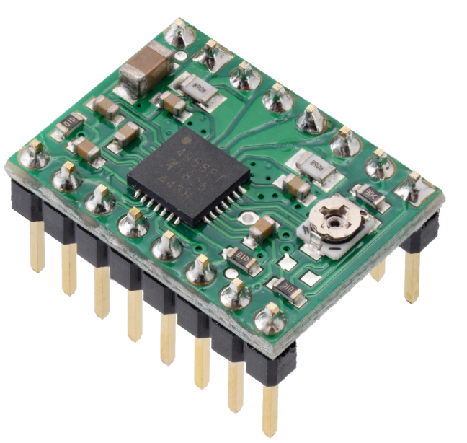
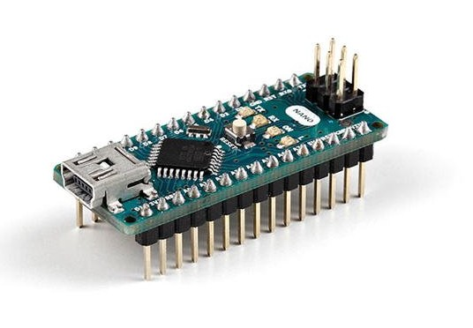
Hardware Overview - The Stepper Driver
Driver:
Model: A4988
Input Voltage: 0 to 35 [V]
Output Voltage: -2 to 37 [V]
Microstepping: ½, ¼ , ⅛, 1/16
Microcontroller:
Model: Arduino Nano
Clock Speed: 16 [MHz]
10/36

Slide 14
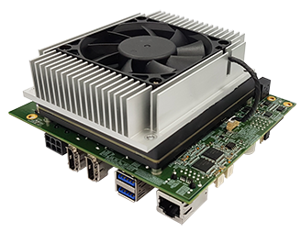
Hardware Overview - Computer
Model: Nvidia Jetson AGX Xavier
OS: Linux, Ubuntu (Jetpack)
CPU: 8-core ARM x64
GPU: 512-core Volta
11/36

Slide 15

Block Diagrams

Slide 16
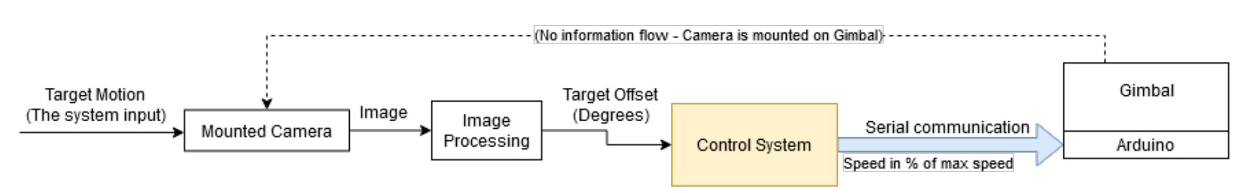
Block Diagrams - Top Level
12/36

Slide 17
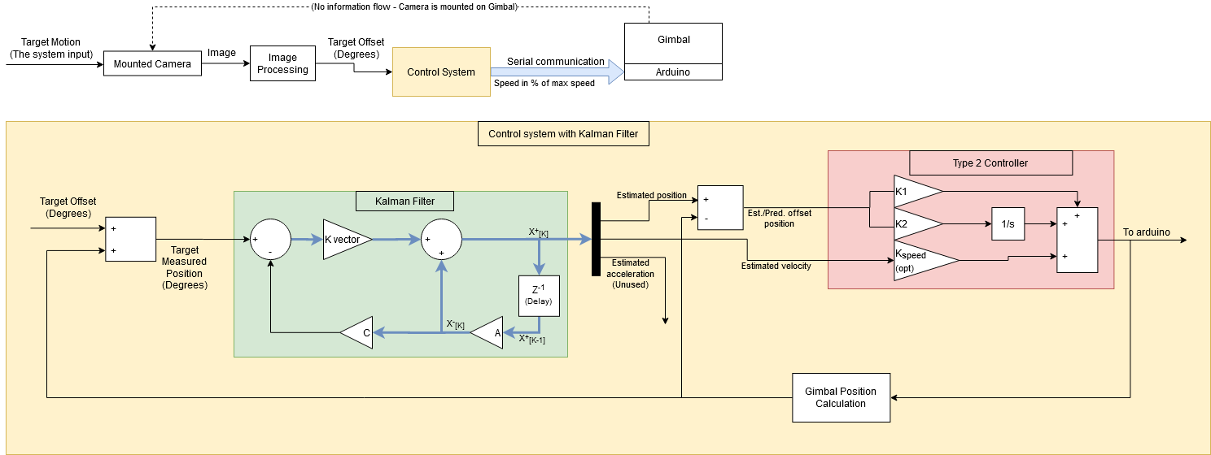
Block Diagrams - Control System
13/36

Slide 18

Block Diagrams - E2E Delay
“Glass-to-glass video latency, also called end-to-end (E2E) video delay, is indicating the period of time from when the photons of a visible event pass through the lens glass of the camera till the moment when the nal image is delivered to the glass of the monitor.”
Source: ximea
14/36

Slide 19
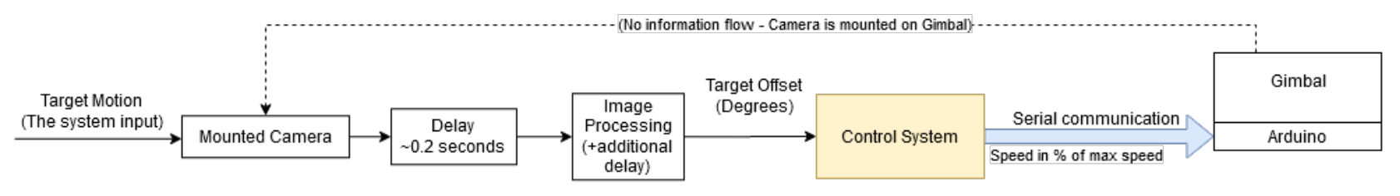
Block Diagrams - Control System + E2E Delay
15/36

Slide 20
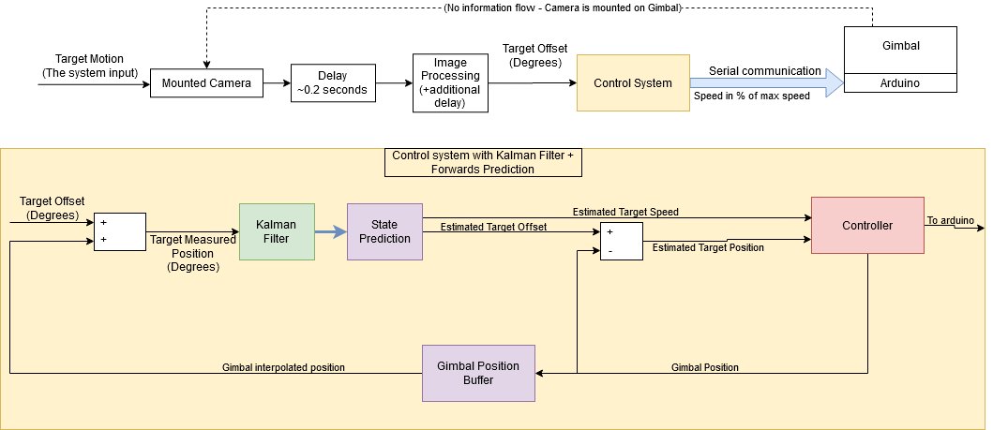
Block Diagrams - Control System + E2E Delay
16/36

Slide 21

Integration

Slide 22
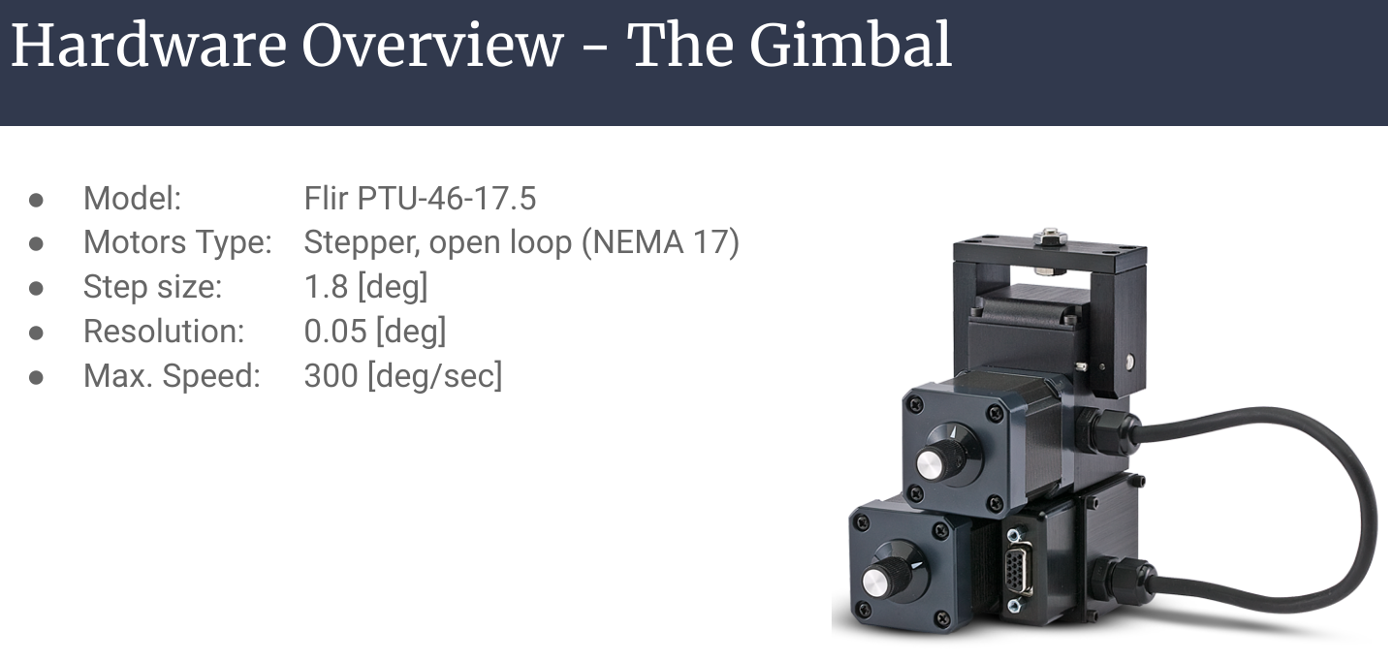
Integration - Optimizing for the A4988 Driver
Remindier: The controller has changed
The PTU-46-17.5 specs are the upper bound for the performance we can get
The true performance will be determined by the input voltage and microstepping configuration
Call out key parts of the UI

Slide 23
Integration - Optimizing for the A4988 Driver
Remindier: The controller has changed
The PTU-46-17.5 specs are the upper bound for the performance we can get
The true performance will be determined by the input voltage and microstepping configuration
Call out key parts of the UI

Slide 24
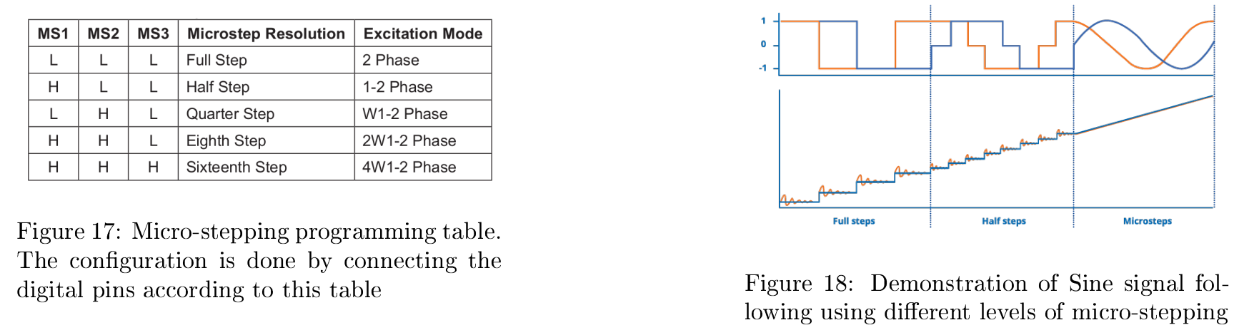
Integration - Optimizing for the A4988 Driver
Raising input voltage
Enabling Micro-stepping
17/36
Notes:
Micro-stepping obviously improves the angular precision, but alongside it may help to improve angular velocity

Slide 25
Integration - Optimizing for the A4988 Driver
Enabling Micro-stepping
Notes:
Micro-stepping obviously improves the angular precision, but alongside it may help to improve angular velocity

Slide 26
Integration - Optimizing for the A4988 Driver
Supplying Higher Voltage
Problems with high frequency
The torque become too low → slipping
The relation to micro-stepping
Microstepping → slower rotation → compensate with higher frequency
Notes:
Micro-stepping obviously improves the angular precision, but alongside it may help to improve angular velocity

Slide 27
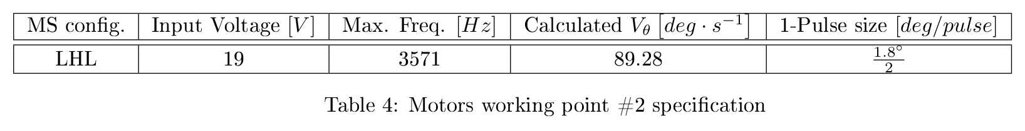
Integration - Optimizing for the A4988 Driver
Our current working point:
* LHL = quarter step

Slide 28
Integration - Arduino Code
Discussion: Controlling the A4988 Driver

Slide 29
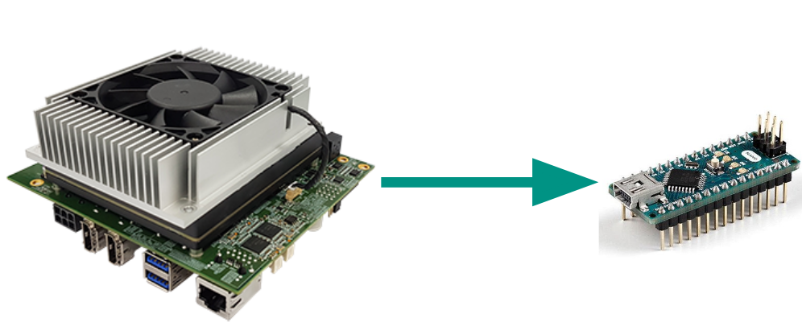
Integration - Arduino Code
Send Arduino commands
Moving the gimbal
Implement Parallelism between 2-Axes
18/36

Slide 30
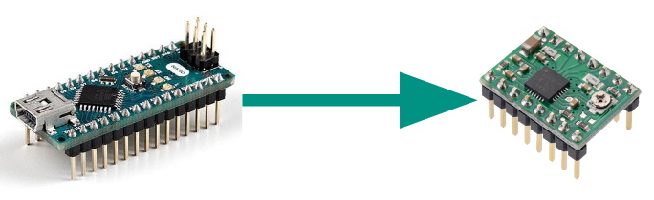
Integration - Arduino Code
Send Arduino commands
Moving the gimbal
Implement Parallelism between 2-Axes
19/36

Slide 31
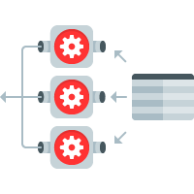
Integration - Arduino Code
Send Arduino commands
Moving the gimbal
Implement Parallelism between 2-Axes
20/36

Slide 32

In-Depth Control Review

Slide 33
Control Review - System Modeling
Model the system as a linear system
Model the target motion as constant acceleration with noise
Measurements are the target’s relative position to the gimbal
Use a Kalman filter to get information about targets:
Position
Speed
acceleration
21/36

Slide 34
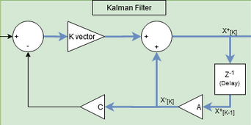
Control Review - Kalman Filter
Implemented as a standard discrete Kalman filter
Iterative process. For each processed image:
Calculate a K vector
If stationary, K vector is a constant
Predict state vector according to model
Correct state vector according to measurement and K vector
22/36

Slide 35
Control Review - Kalman Filter
Code has options for stationary and non stationary filter, default is non stationary as:
Performance is not adversely affected by it
Better if time between each image processed varies
However, results are usually the same as K vector eventually converges to the stationary value
23/36

Slide 36
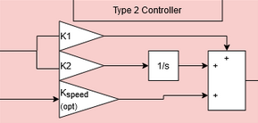
Control Review - Controller
Kalman filter outputs position, speed and acceleration
Acceleration output is noisy and inaccurate so is not used
Add discrete approximation of integral on position
Result is a standard PID controller
24/36

Slide 37
Control Review - Camera Delay
Delay from camera output to controller output is around 0.2-0.3 seconds.
It is mostly due to limitations in camera hardware
This creates problem with position calculation and tracking
Best solution is to get a better camera
Using the current gear, best solution is forward prediction
25/36

Slide 38
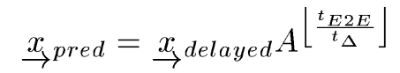
Control Review - Forward Prediction
Add buffer to gimbal position to simulate delay
Linear prediction according to:
Time delay value (Input to the system)
Average time between images (delta)
Predict forward to correct amount of steps
26/36

Slide 39
Control Review - Forward Prediction
The Good: Good tracking when target is in constant acceleration
The Bad: Performs poorly when target has sharp changes in acceleration:
Example: Gimbal overshoots when target abruptly changes direction
27/36

Slide 40
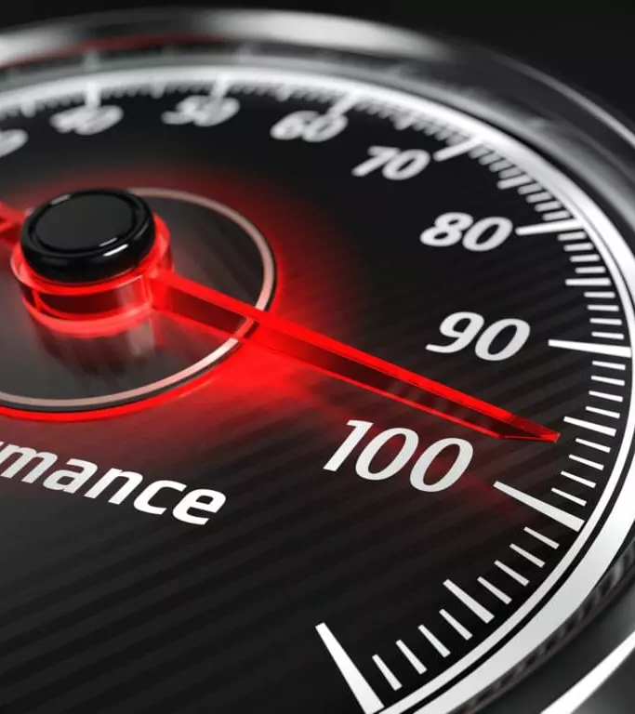
Performance

Slide 41
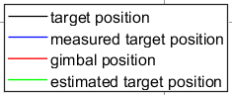
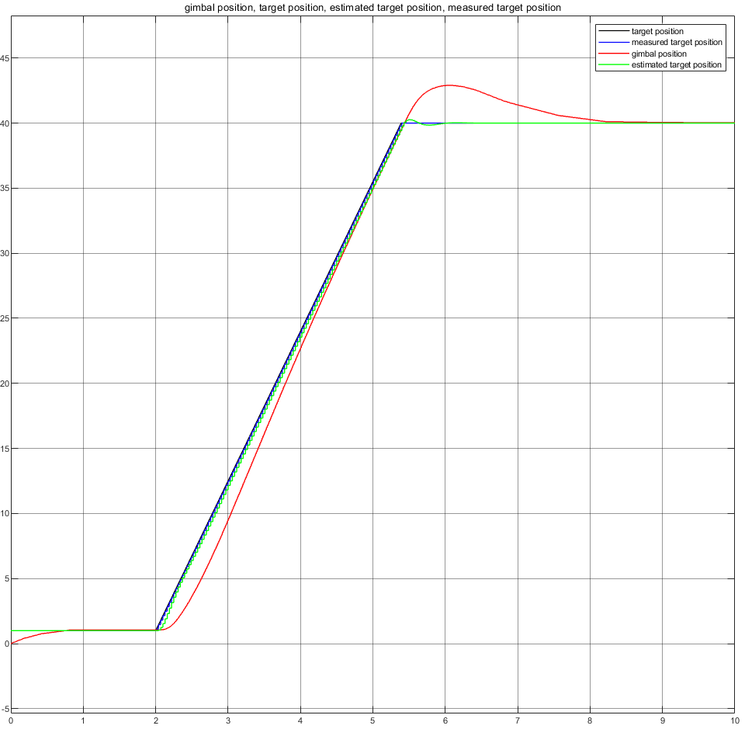
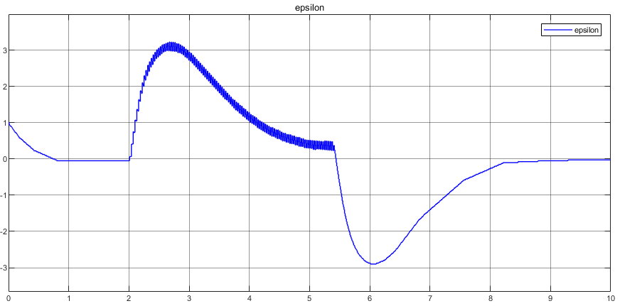
Performance - Simulation
B
Baseline simulation:
28/36

Slide 42
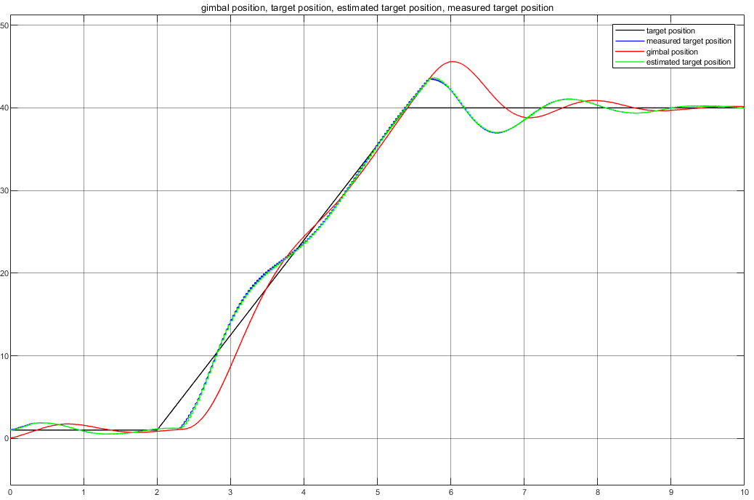
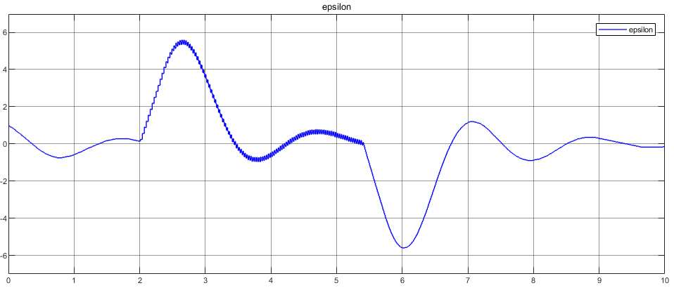
Performance - Simulation
B
The effects of E2E delay:
29/36

Slide 43
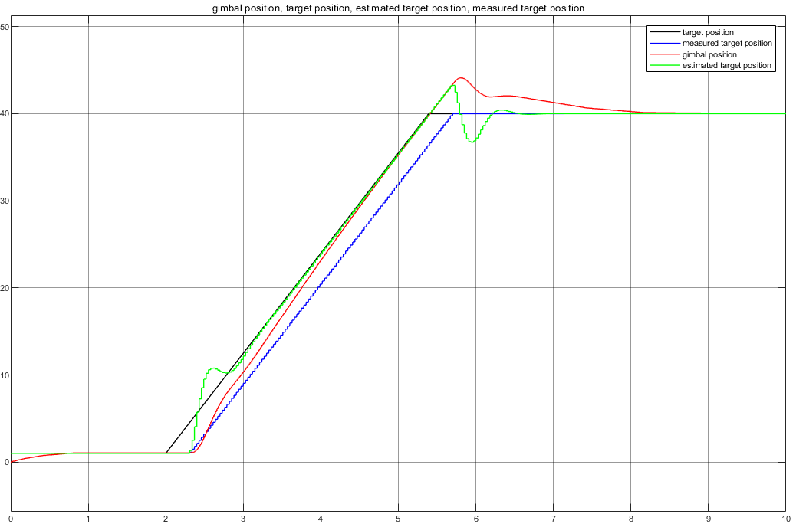
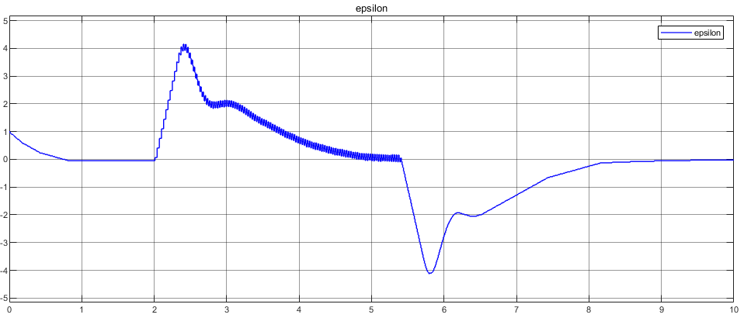
Performance - Simulation
B
E2E delay with correction:
30/36

Slide 44
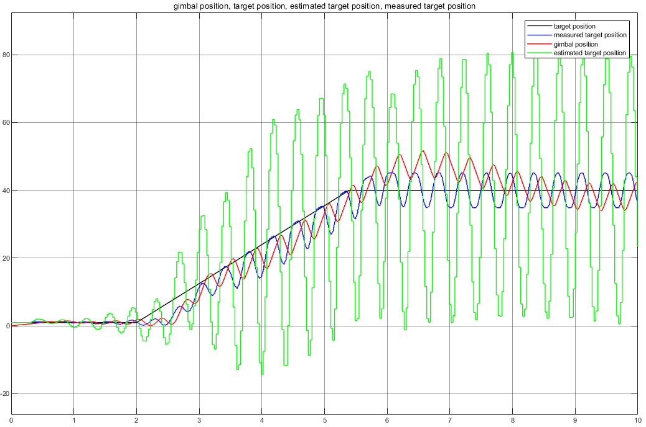
Performance - Simulation
B
When predicting using the wrong E2E delay:
31/36

Slide 45
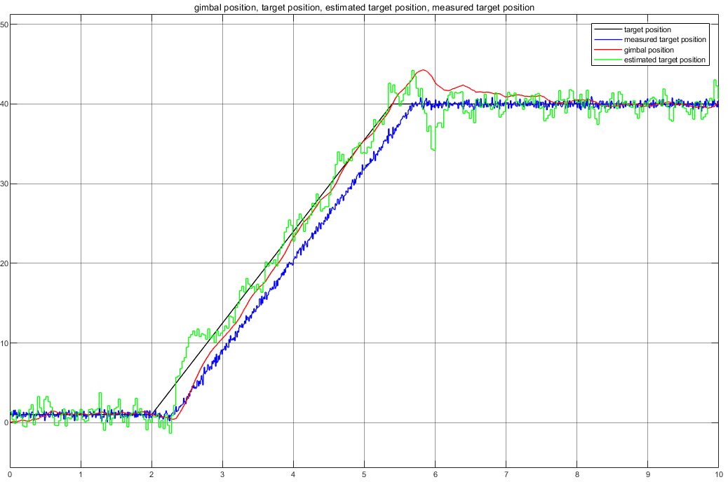

Performance - Simulation
B
Add noise:
32/36

Slide 46
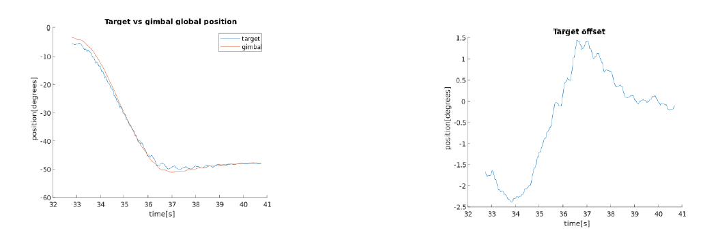
Performance - Real Life - PID = 4, 6, 0.1
33/36

Slide 47
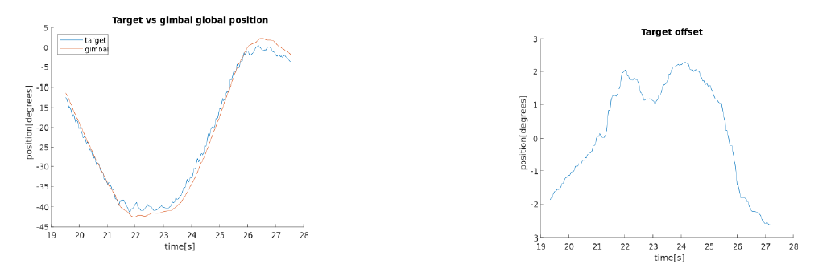
Performance - Real Life - PID = 4, 4, 0.1
34/36

Slide 48
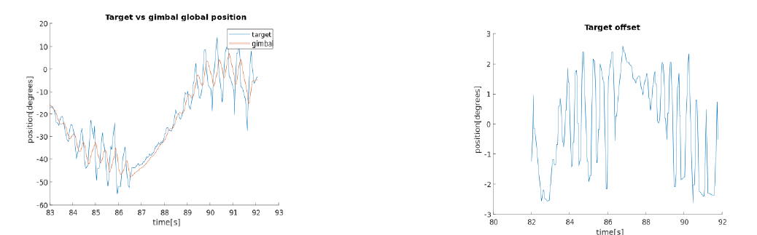
Performance - Real Life - PID = 6, 6, 0.1
35/36

Slide 49

Summary & Conclusions

Slide 50
Summary & Conclusions
Input delay is the bottleneck for good following performance in this project
It cannot be fully overcome using prediction
It’s affect is amplified with higher types of the system
Working with open-loop system is complex and can cause inaccuracy
Relying on relative input value is less stable than absolute input value
Simulating a code-based system is not always trivial, at least with Simulink
Performing real-life experiments might involve additional challenges and additional noise
Traditional Kalman Filter is not suited for complex motion profiles
36/36

Slide 51
Questions?

Slide 52
Link to video

Slide 53
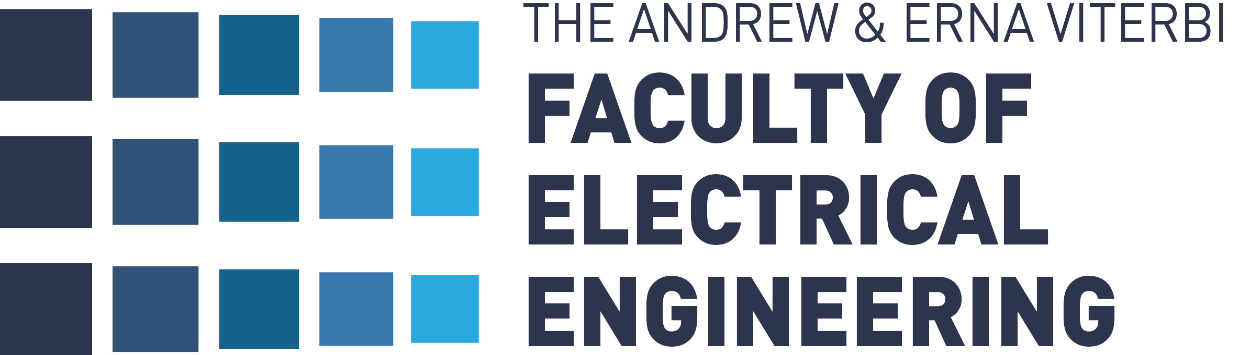

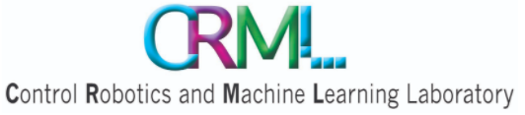
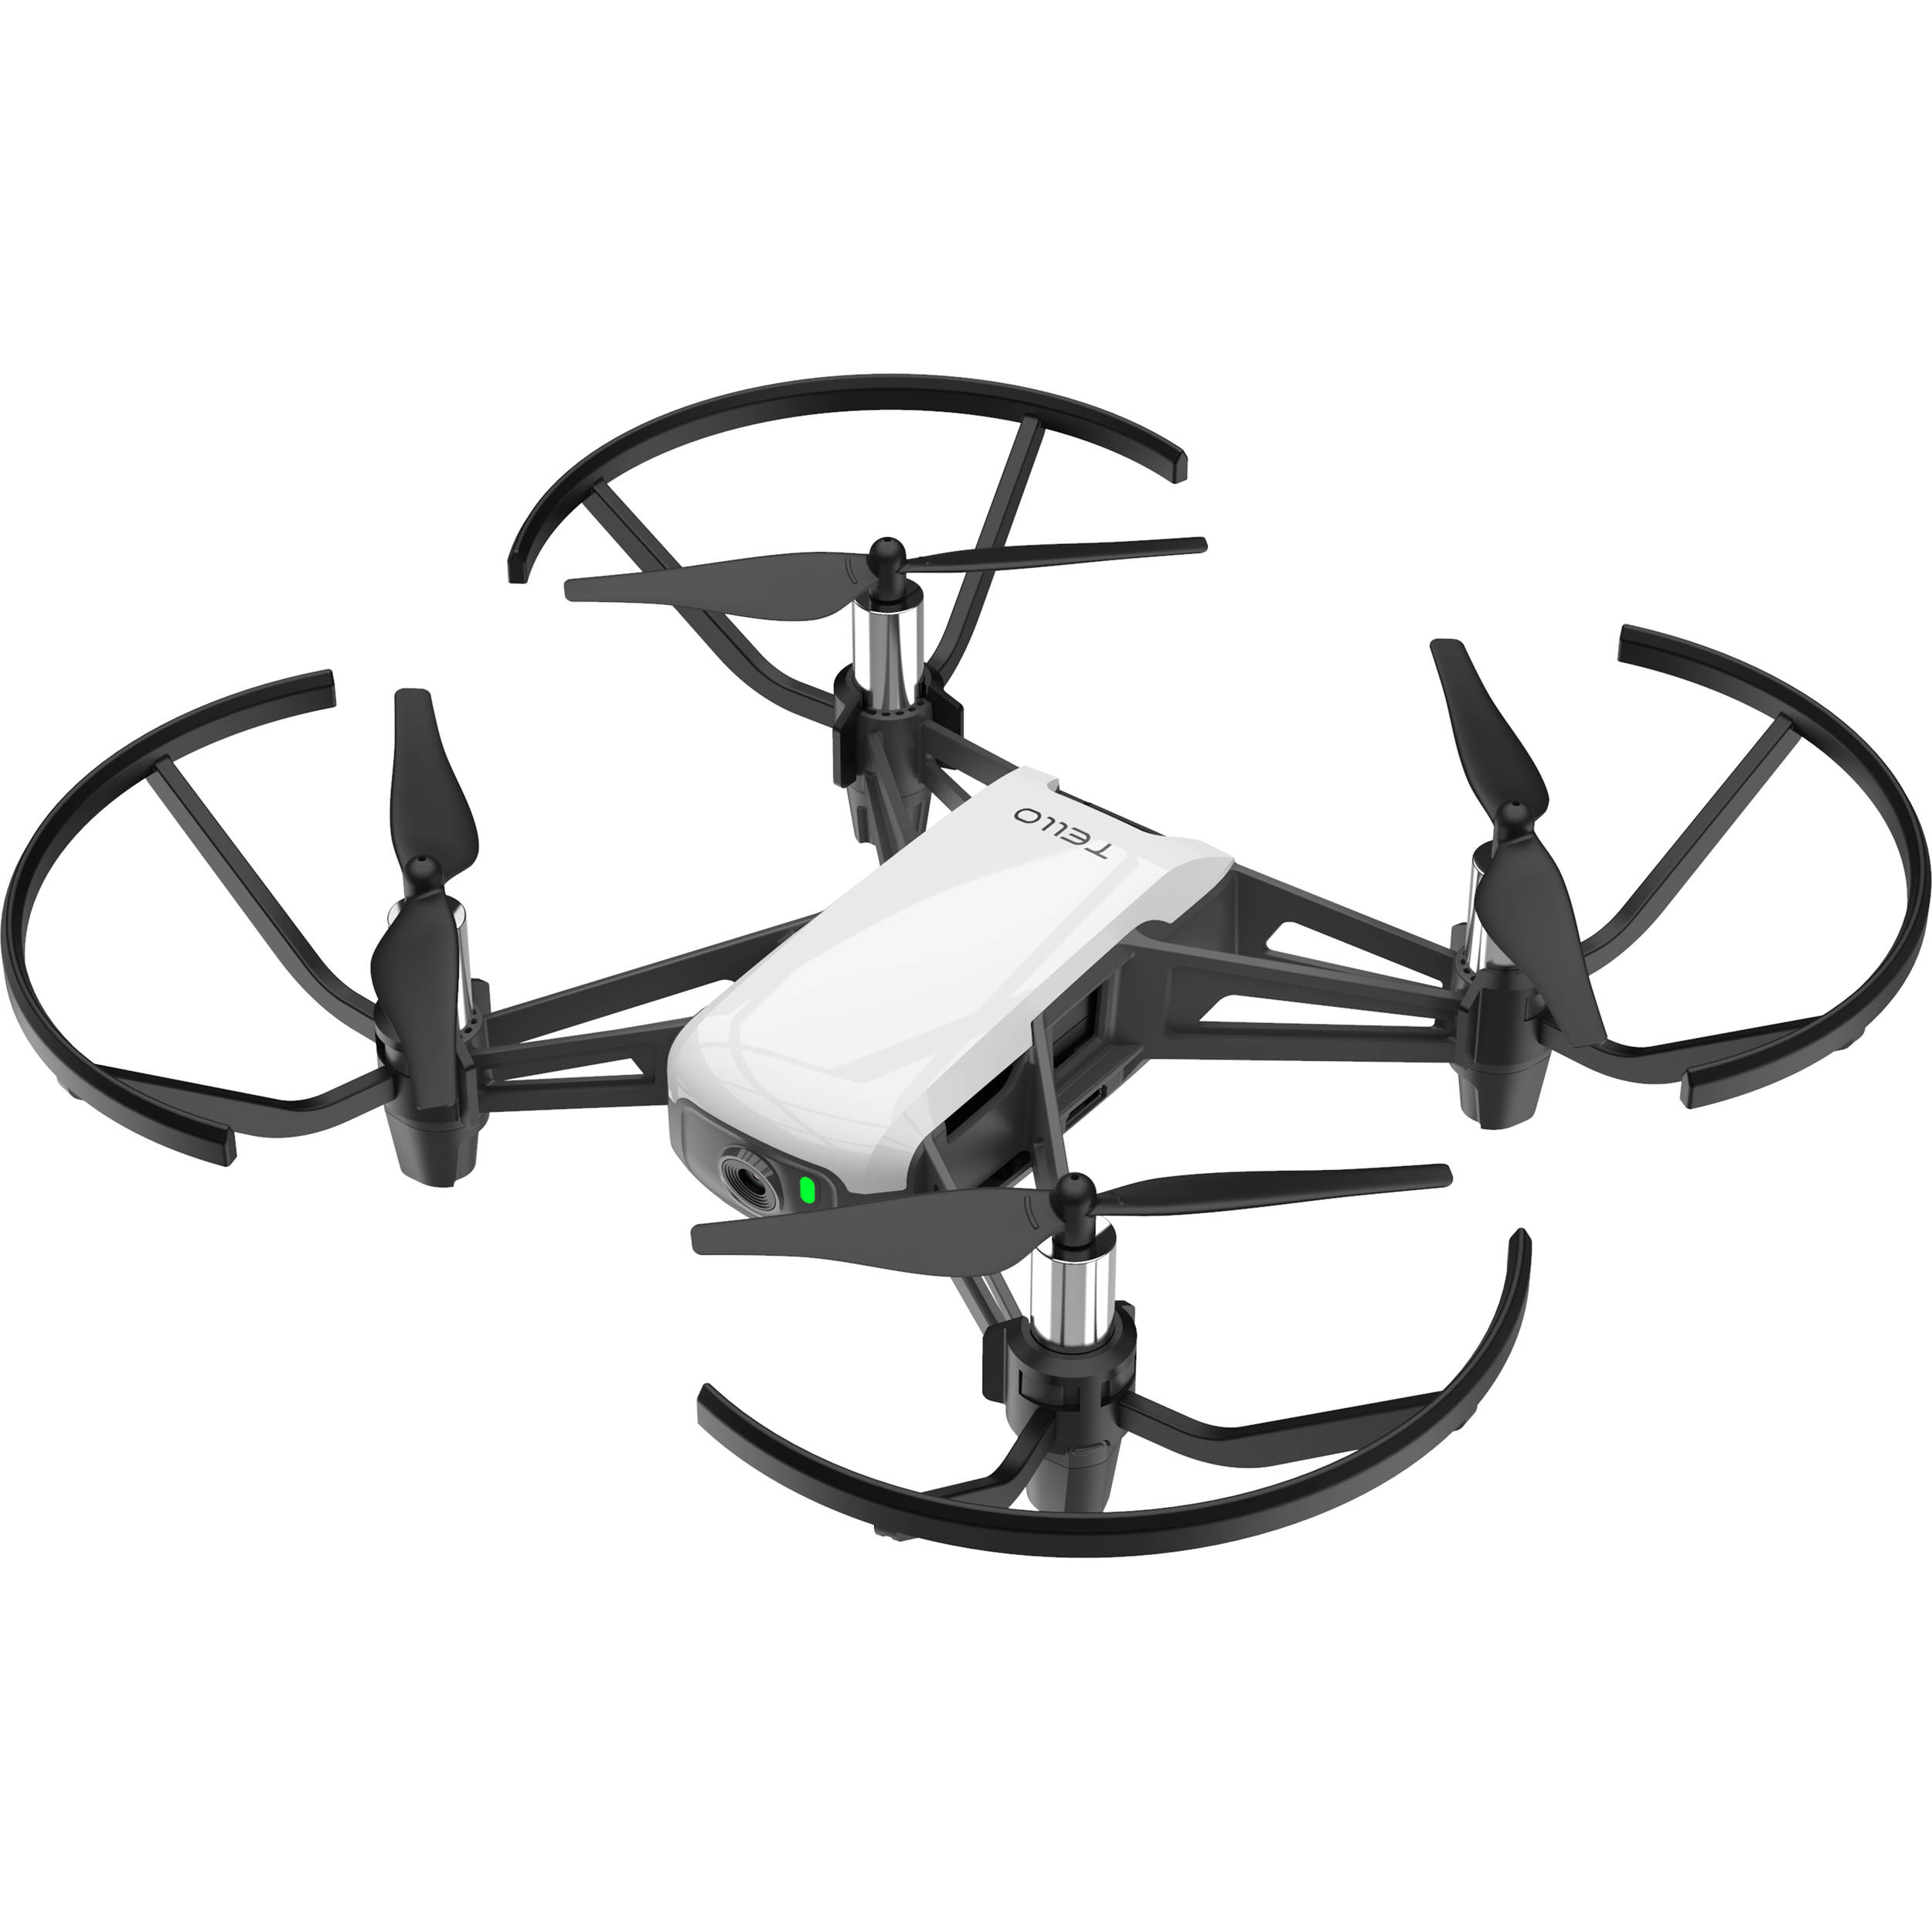
Amir Sarig
&
Idan Anner
Supervised by Ilan Rusnak

Slide 54
Controlling A Gimbal to Follow A Drone, Handling Input Delay with Prediction

Slide 56
Modeling The System

Slide 58
Simulate and Tune

Slide 59
Drone Coordinates as Input

Slide 60
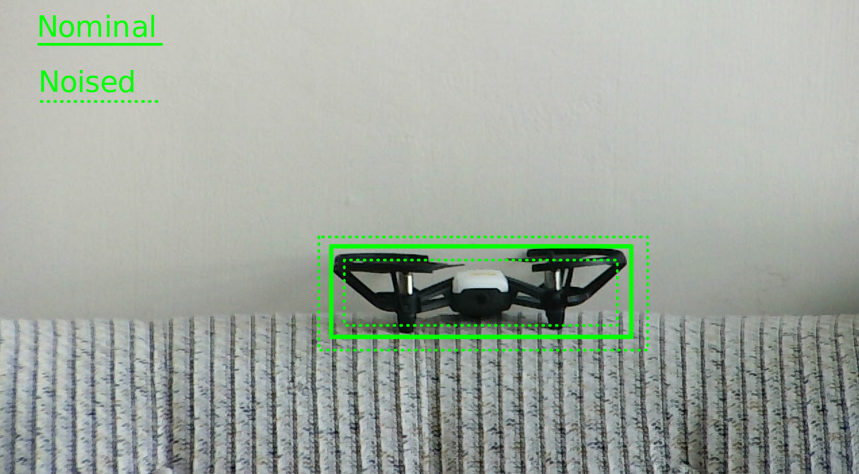

Slide 61
Camera’s Delay
Characterized

Slide 62
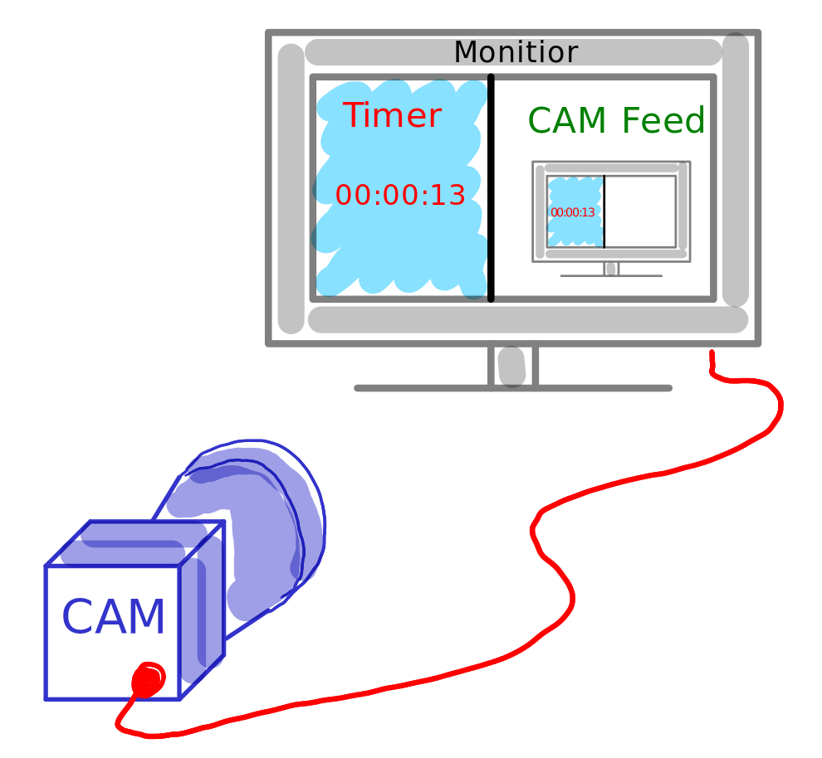

Slide 63
Add Prediction

Slide 64
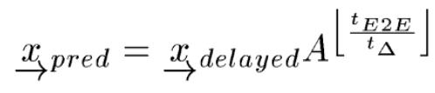
m_est^

Slide 65
Achieve Great Tracking

Slide 67
October 2020

